Slide 1

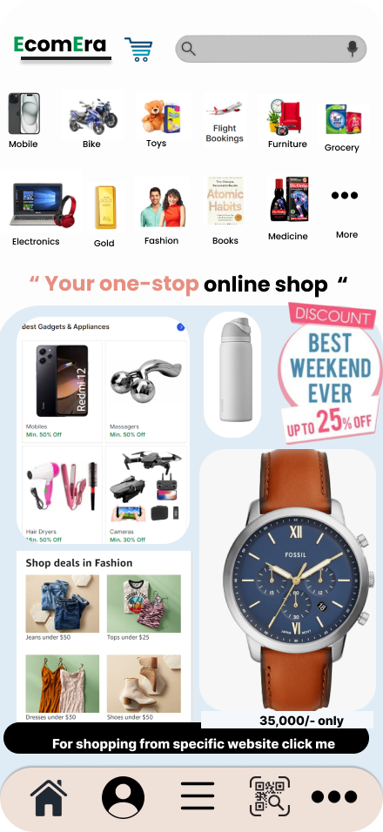
Introduction to EcomEra: Revolutionizing the E-commerce Experience
EcomEra aims to revolutionize the online shopping experience by simplifying the user journey and enhancing customer satisfaction. This innovative platform seeks to address the challenges faced by both customers and businesses in the modern e-commerce landscape.

Slide 2

Key Features of EcomEra: Enhancing Usability and Engagement
1
Personalized Recommendations
2
Seamless Checkout Process
EcomEra leverages AI-powered algorithms to provide tailored product suggestions, improving user engagement and conversion rates.
A streamlined checkout experience reduces friction points, leading to higher customer satisfaction and increased completion rates.
3
Interactive Product Visualizations
4
Live Chat Support
EcomEra incorporates 360-degree product views and augmented reality features, allowing customers to experience products in a realistic way.
Real-time assistance from customer service agents ensures quick resolution of queries and enhances the overall user experience.

Slide 3
Market Analysis: Identifying Opportunities and Addressing User Needs
Growing E-commerce Market
Customer Expectations
Competitive Landscape
The e-commerce market is experiencing rapid growth, driven by the increasing adoption of online shopping.
Modern consumers demand personalized experiences, seamless checkout, and excellent customer support.
EcomEra must differentiate itself from existing platforms by offering unique features and innovative solutions.

Slide 4
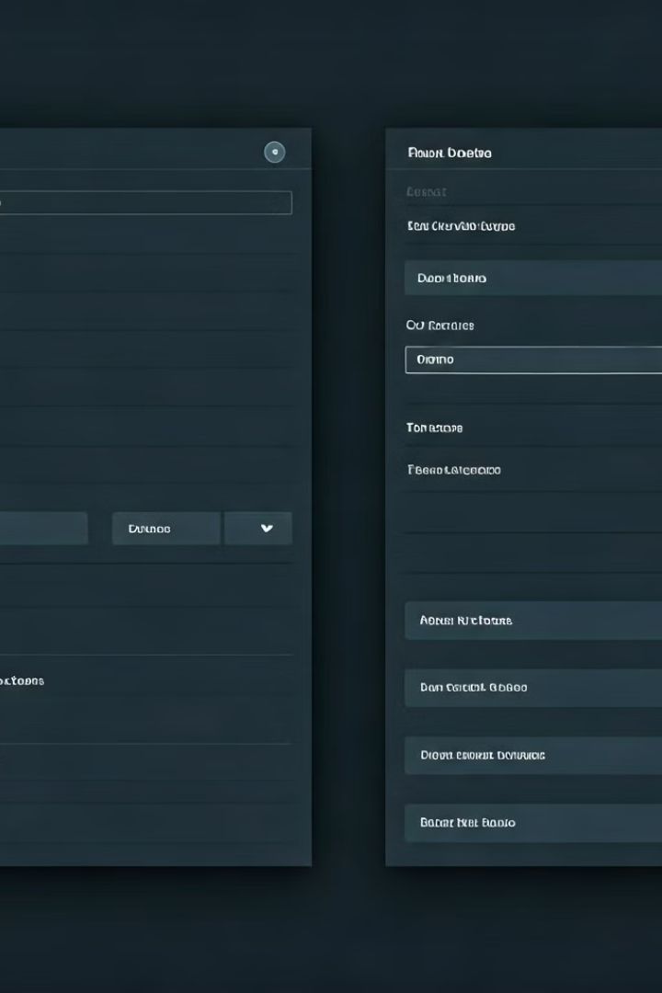



Applying HCI Principles: Feedback, Consistency, and Error Prevention
Feedback
EcomEra provides clear and timely feedback to users throughout their journey, informing them of their actions and system status.
Consistency
A consistent interface design ensures users can navigate and interact with the platform seamlessly and intuitively.
Error Prevention
EcomEra incorporates design elements that minimize errors, such as input validation and clear instructions, to prevent user frustration.

Slide 5

Prototype Development: Iterative Design and User-Centric Approach
1
2
3
Initial Prototype
User Testing
Iterative Refinement
A basic prototype is developed to test core functionality and gather initial user feedback.
User testing is conducted to gather feedback on the prototype's usability and identify areas for improvement.
The prototype is iteratively refined based on user feedback, leading to a more user-friendly and effective design.

Slide 6
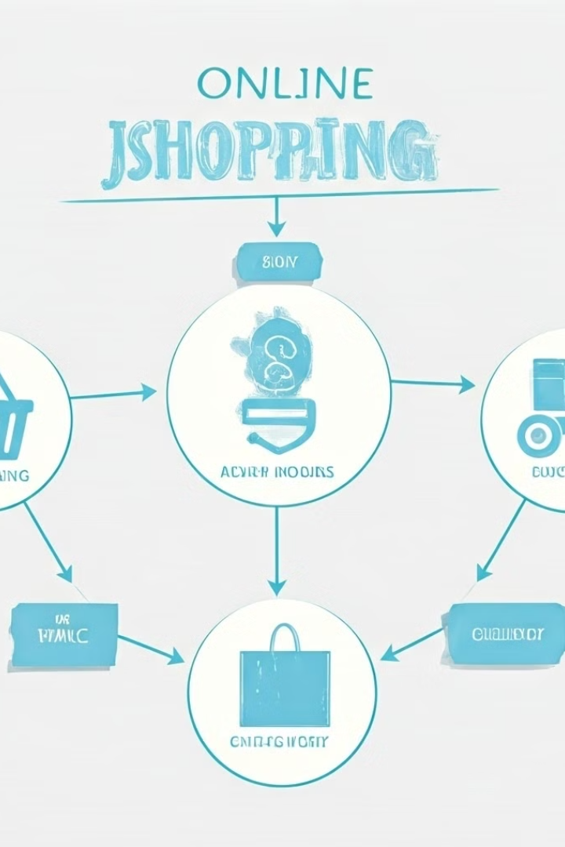
Scenario Building: Crafting Seamless Customer Journeys
Scenario 1: New User Discovery
Scenario 2: Returning Customer Purchase
A new user discovers EcomEra through social media and explores product categories, adding items to their cart.
A returning customer logs in, receives personalized recommendations, and purchases a product using their saved payment information.
Scenario 3: Customer Support Interaction
A customer contacts customer support for assistance with an order, receiving quick and efficient resolution through live chat.

Slide 7

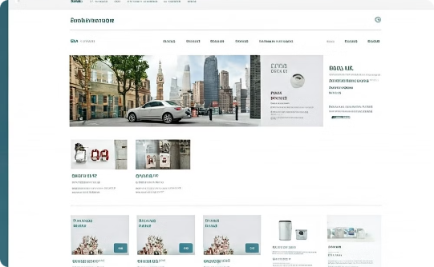
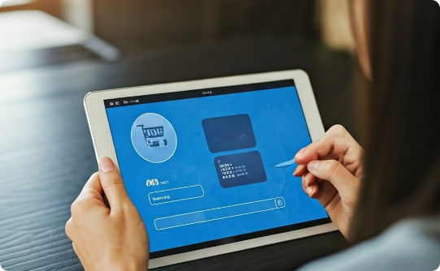
Interface Design: Intuitive and Visually Appealing Experiences
Product Detail Page
Homepage
Checkout Process
The product detail page should provide comprehensive information, including product description, images, reviews, and pricing.
The homepage should be engaging and informative, showcasing featured products, promotions, and personalized recommendations.
The checkout process should be straightforward and secure, allowing users to easily enter their shipping and payment information.

Slide 8

Contextual Inquiry: Understanding User Behaviors and Workflows
Method
Description
Observation
Observing users as they navigate and interact with the platform, noting their behaviors and challenges.
Interviews
Conducting in-depth interviews with users to gather feedback on their experiences and expectations.
Surveys
Distributing surveys to a larger sample of users to collect quantitative data on their preferences and satisfaction.

Slide 9
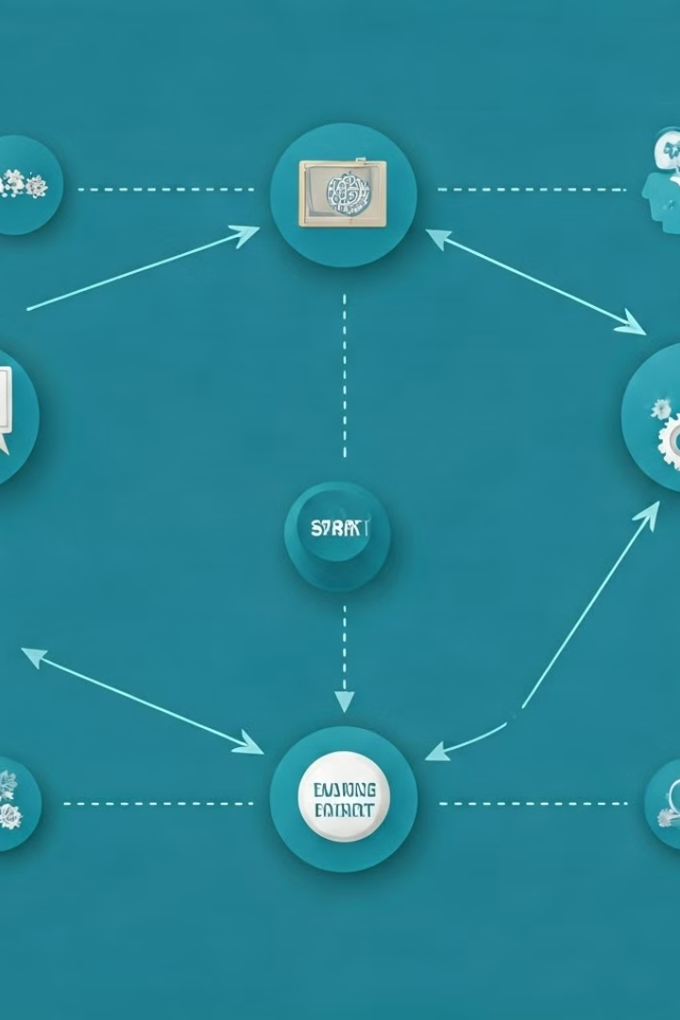



Work Redesign: Optimizing Business Processes for EcomEra
Automation
Automating repetitive tasks, such as order processing and inventory management, to improve efficiency and reduce errors.
Collaboration
Enhancing communication and collaboration between different departments to ensure smooth operations and customer satisfaction.
Data Analysis
Leveraging data analytics to identify areas for improvement and optimize business processes based on user behavior and market trends.

Slide 10

Conclusion and Next Steps: Embracing the Future of E-commerce
EcomEra has the potential to redefine the e-commerce landscape by providing a user-centric and innovative platform. Future development will focus on enhancing personalization, incorporating emerging technologies, and expanding into new markets.

